Slide 1
Air Force Institute of Technology
Cyber-Physical System Intrusion: A Case Study of
Automobile Identification Vulnerabilities and
Automated Approaches for Intrusion Detection
2d Lt David Crow
GCS, ENG 20M, AFIT
Cyber-Physical System Intrusion: A Case Study of
Automobile Identification Vulnerabilities and
Automated Approaches for Intrusion Detection
2d Lt David Crow
GCS, ENG 20M, AFIT

Slide 2
Overview
Motivation
Background & related work
Identifying vehicles
Experimental data
Methodology
Results
Detecting intrusion
Experimental data
Methodology
Results
Conclusions
Motivation
Background & related work
Identifying vehicles
Experimental data
Methodology
Results
Detecting intrusion
Experimental data
Methodology
Results
Conclusions

Slide 3
Motivation
An attacker familiar with the design of a specific vehicle’s
controller area network (CAN) can better attack the vehicle

Slide 4
Research Question 1
Do the packets that broadcast on a vehicle’s
CAN bus uniquely identify the vehicle?

Slide 5
Motivation
Intrusion detection systems (IDSs) are a common
method to protect computer networks from intrusion

Slide 6
Research Question 2
Can we develop an effective IDS for a
cyber-physical system (CPS) like the CAN?

Slide 7
Overview
Motivation
Background & related work
Identifying vehicles
Experimental data
Methodology
Results
Detecting intrusion
Experimental data
Methodology
Results
Conclusions

Slide 8
Cyber-Physical Systems
“systems where the cyber parts, i.e., the computing and communication parts, and the physical parts are tightly integrated, both at the design time and during operation”
Difficult to replicate a CPS’s model ⟶ CPS monitoring
Output of CPS monitoring: time series data

Slide 9
Time Series Data
“(a) Google stock price for 200 consecutive days; (b) Annual number of [labor] strikes in the US; (c) Annual price of a dozen eggs in the US (constant dollars); (d) Monthly total of pigs slaughtered in Victoria, Australia; (e) Annual total of lynx trapped in the McKenzie River district of north-west Canada; (f) Monthly Australian electricity production.”

Slide 10
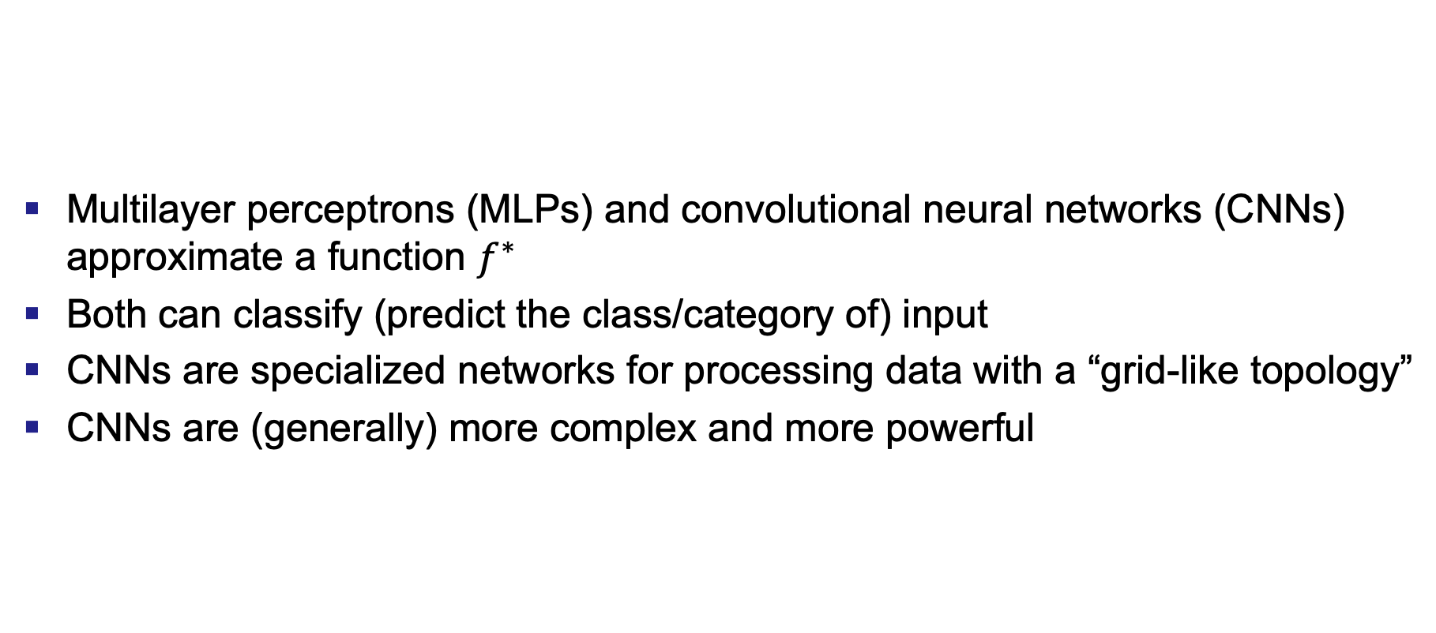
Deep Learning
Multilayer perceptrons (MLPs) and convolutional neural networks (CNNs) approximate a function $f^{∗}$
Both can classify (predict the class/category of) input
CNNs are specialized networks for processing data with a “grid-like topology”
CNNs are (generally) more complex and more powerful

Slide 11
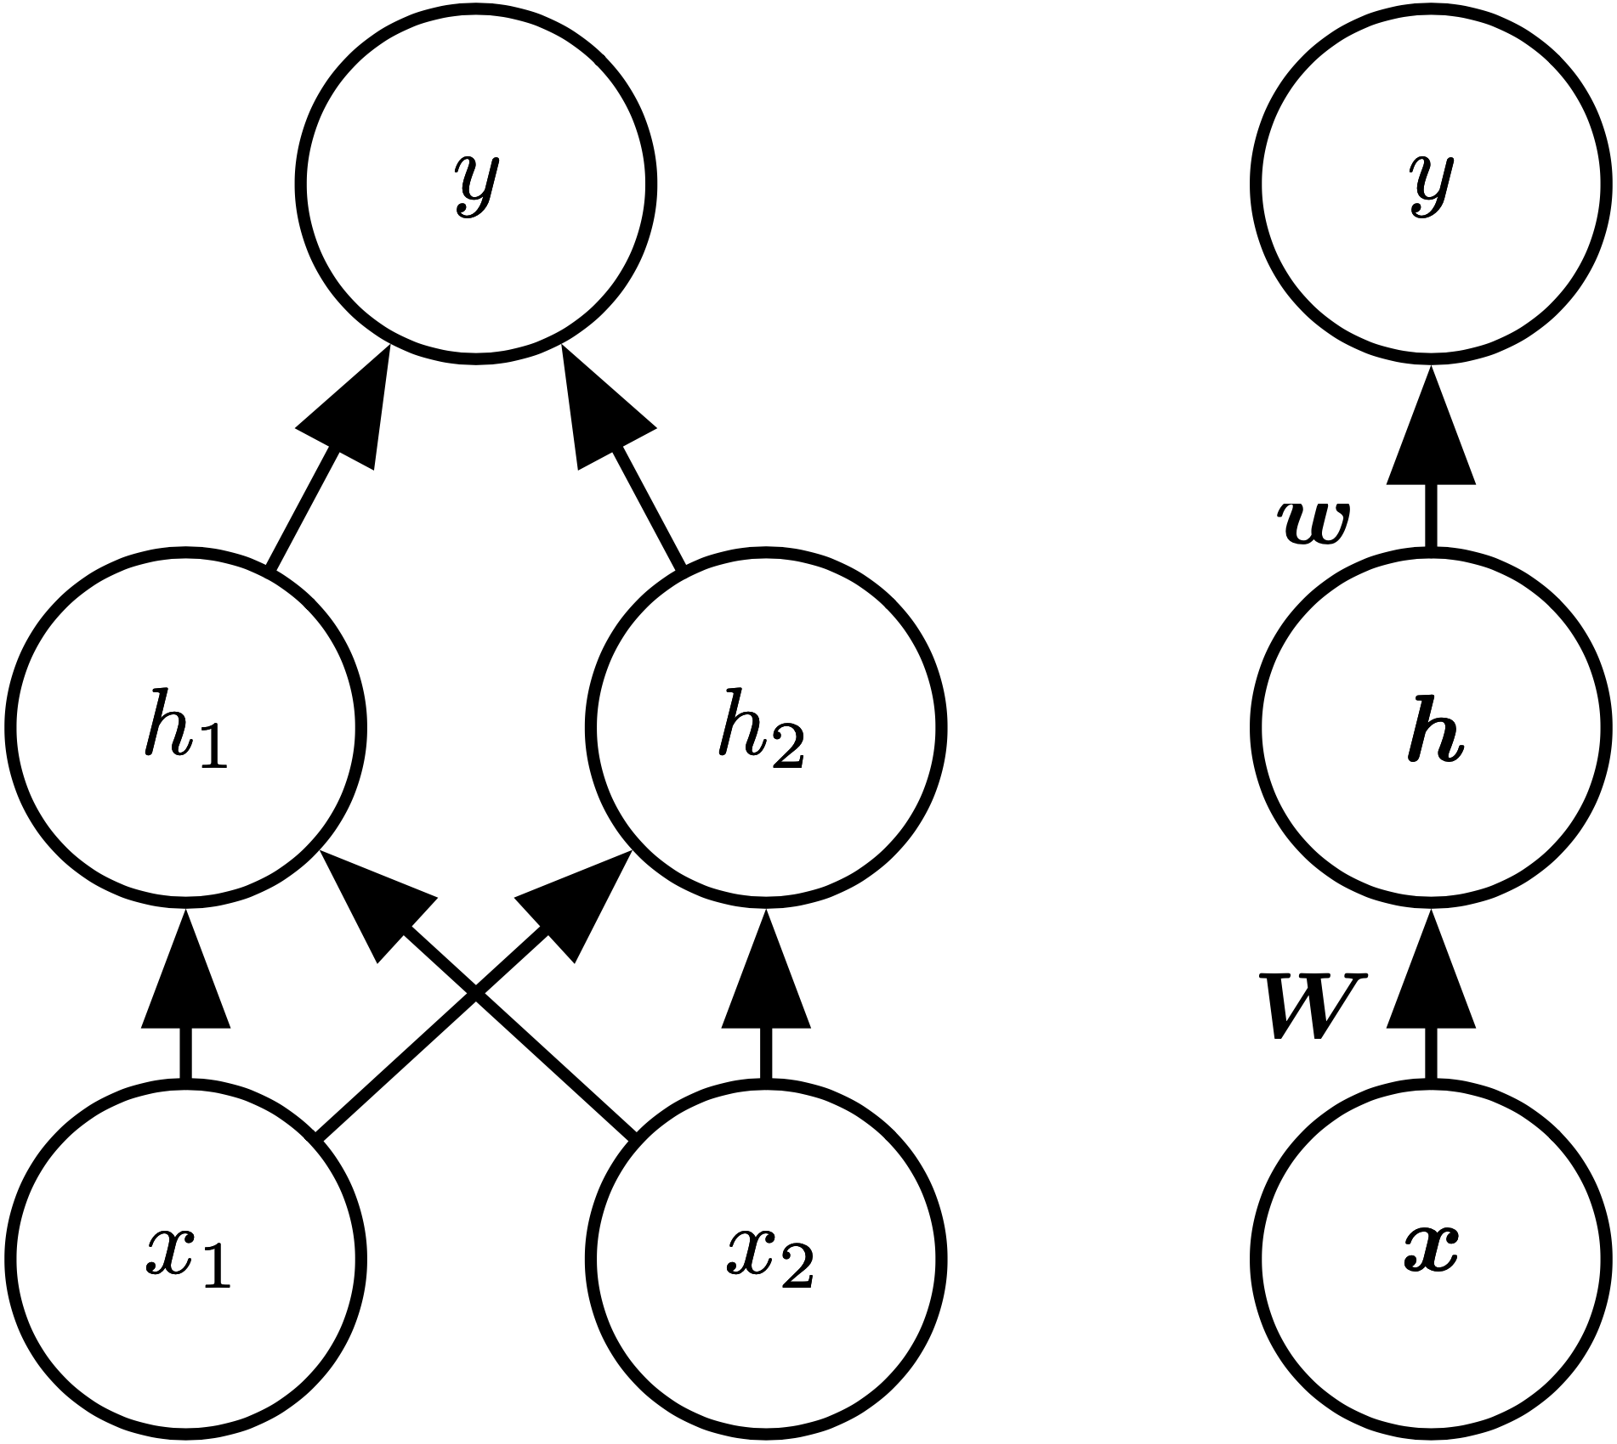
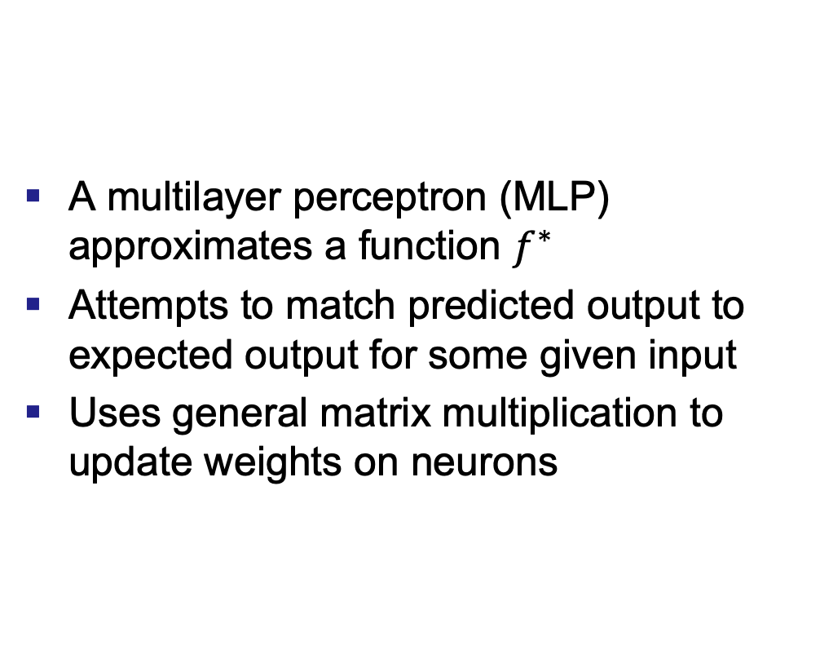
Neural Networks
A multilayer perceptron (MLP) approximates a function $f^{∗}$
Attempts to match predicted output to expected output for some given input
Uses general matrix multiplication to update weights on neurons
“An example of a feedforward network, drawn in two different styles ... It has a single hidden layer containing two units.”

Slide 12
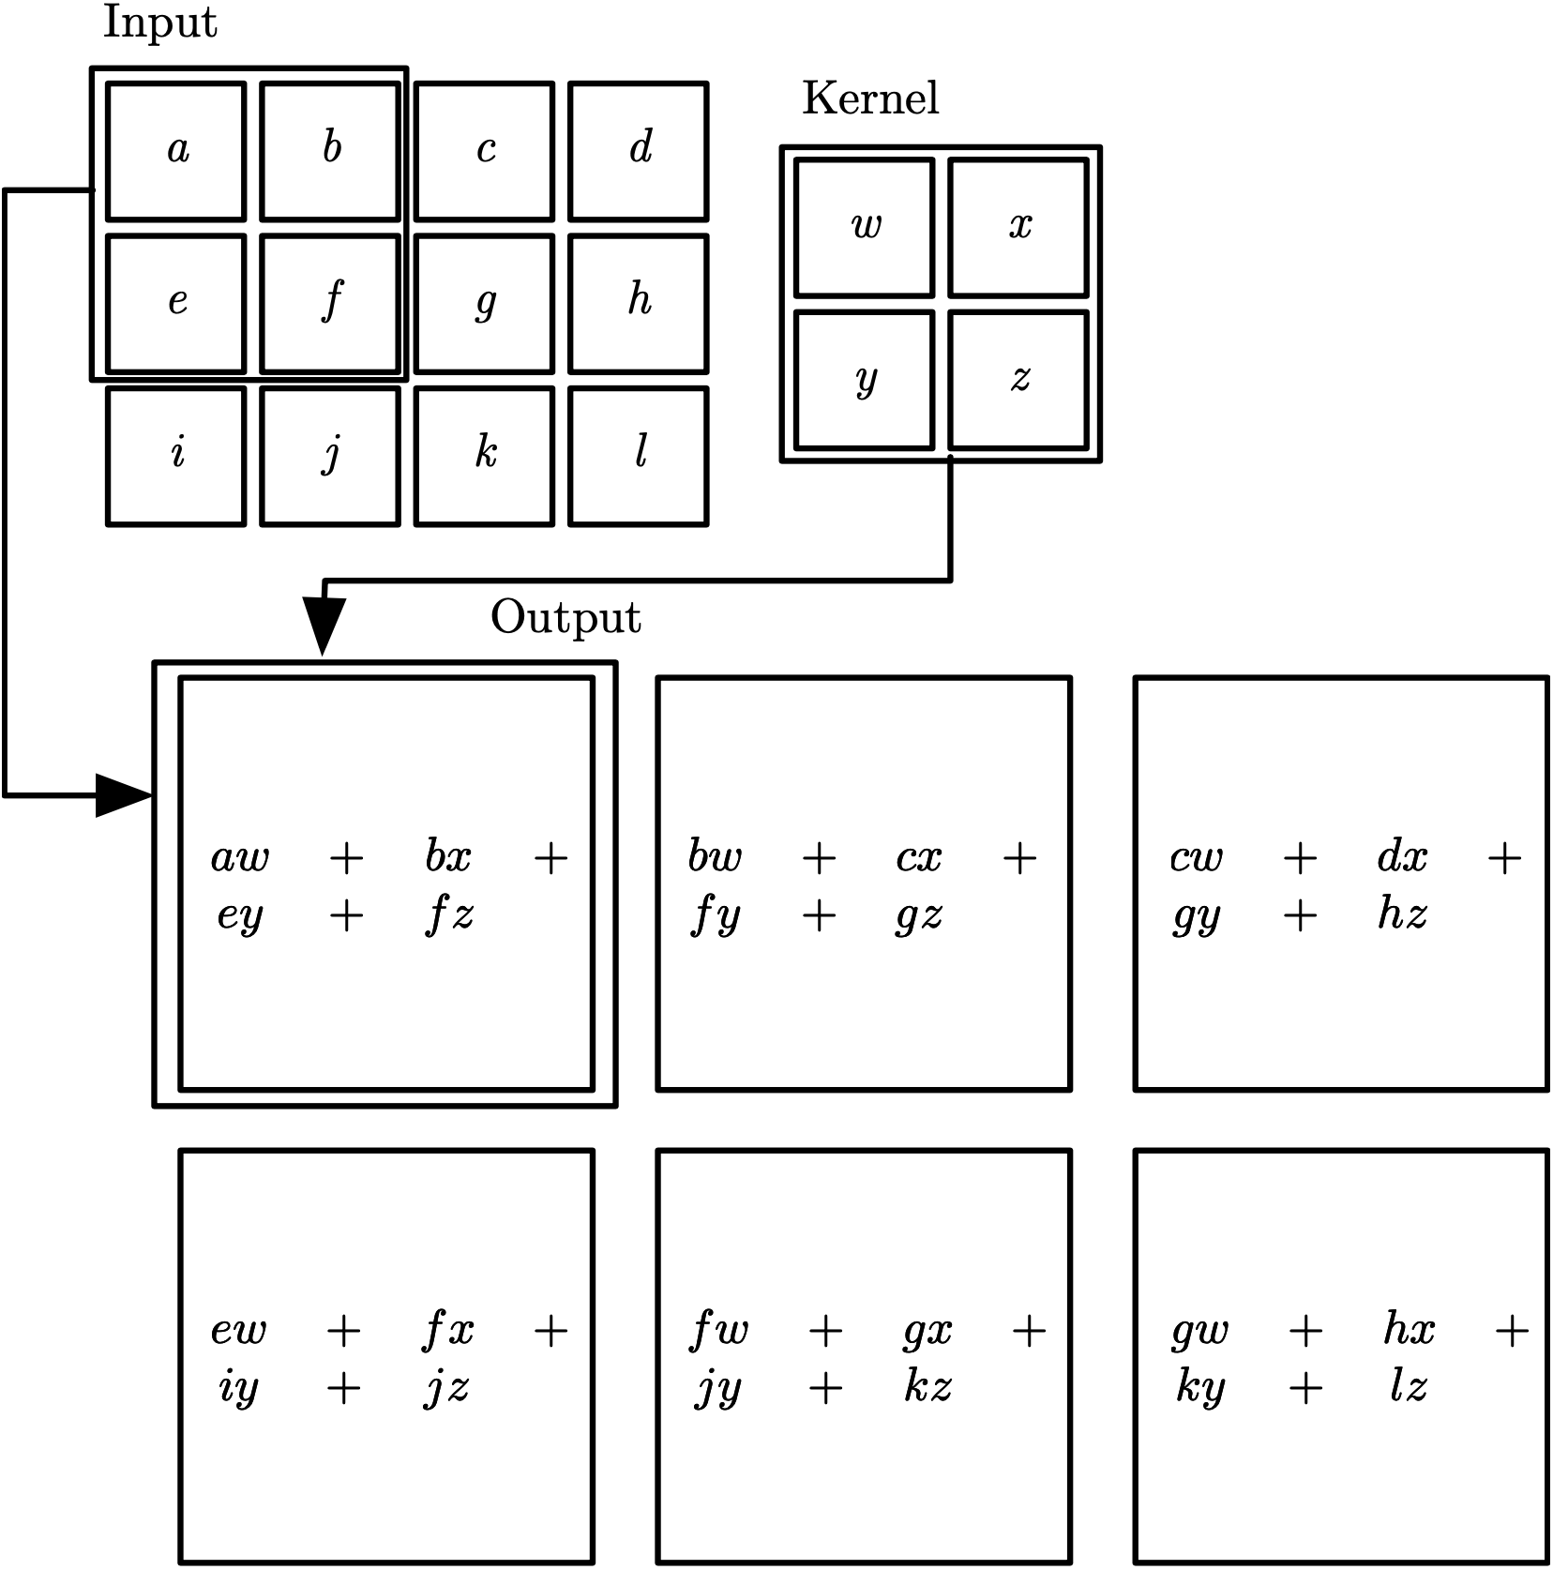
Convolutional Neural Network
A convolutional neural network (CNN) processes data with a “known grid-like topology”
Time series are 1-D grids
Uses convolution operation to update weights on neurons
“An example of 2-D convolution ..."

Slide 13
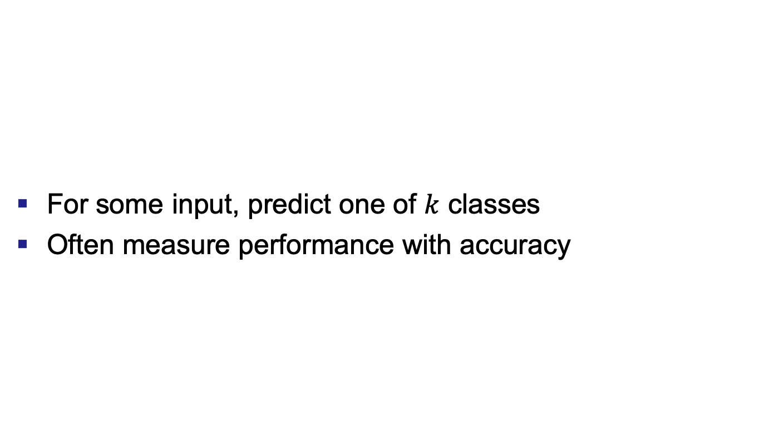
Classification
For some input, predict one of $k$ classes
Often measure performance with accuracy

Slide 14

Controller Area Network

Slide 15
Intrusion Detection Systems
Monitors a network and alerts administrator of intrusion
Two primary types of IDSs
Misuse detection
Anomaly detection
Monitors a network and alerts administrator of intrusion
Two primary types of IDSs
Misuse detection
Anomaly detection

Slide 16
Causality
Relationship between cause and effect
Difficult to measure/quantify
Approximate causality using statistical techniques
Notes:
Causality matters because it’s a physical system

Slide 17

Granger Causality
For two variables $X$ and $Y$:
$Y$ does not precede $X$ in time
$X$ contains info that improves the prediction of $Y$
This info is not contained in any other series
Difficult to confirm these ⟶ predict $Y$ with $X$

Slide 18

Empirical Dynamic Modeling
Panel A
Lorenz system manifold $M$
Projection of $x$ dimension
Panel B
$x$ and two $τ$-lags of $x$
Shadow manifold $M_{x}$
$M$ and $M_{x}$ are diffeomorphic

Slide 19

Empirical Dynamic Modeling
Convergent cross-mapping (CCM)
Original manifold $M$
Shadow manifolds $M_{x}$, $M_{y}$
$M$, $M_{x}$, $M_{y}$ are diffeomorphic

Slide 20
Related Work
CAN security
Predict future CAN data
Classify CAN data samples as normal/abnormal
Classify drivers using reverse-engineered CAN data
Granger causality
Correlate/aggregate alerts to identify important alerts
Determine variables which best predict an attack
Empirical dynamic modeling
None!

Slide 21
Overview
Motivation
Background & related work
Identifying vehicles
Experimental data
Methodology
Results
Detecting intrusion
Experimental data
Methodology
Results
Conclusions

Slide 22
Experimental Data
11 vehicles
230 MB of CAN data
Arbitration identifier (arbID)
Hexadecimal data
Vehicle | Make | Model | Year
1 | Chevrolet | Cobalt | 2009
2 | Chevrolet | Silverado | 2011
3 | Dodge | 1500 | 2014
4 | Ford | F-150 | 2017
5 | Ford | Focus | 2010
6 | Honda | Accord | 2012
7 | Honda | Accord | 2015
8 | Nissan | 370Z | 2015
9 | Nissan | XTERRA | 2010
10 | Saab | 9-7X | 2009
11 | Toyota | Corolla | 2009

Slide 23
Overview
Motivation
Background & related work
Identifying vehicles
Experimental data
Methodology
Results
Detecting intrusion
Experimental data
Methodology
Results
Conclusions

Slide 24
Methodology
For each of three disparate experiments:
Process the data
Iteratively train and evaluate deep learning models
Re-evaluate the optimal models
Train/test using the full dataset
Train/test using a balanced dataset

Slide 25
Exp. 1: Ordered Data
Time
CAN packet
ArbID | … | Data
CAN packet
ArbID | … | Data
CAN packet
ArbID | … | Data
CAN packet
ArbID | … | Data
 | …
Data | Data | Data | Data | … | … | … | … | … | …
Input sample
1024 bytes

Slide 26
Exp. 2: Ordered ArbIDs
Time
CAN packet
ArbID | … | Data
CAN packet
ArbID | … | Data
CAN packet
ArbID | … | Data
CAN packet
ArbID | … | Data
 | …
ArbID | ArbID | ArbID | ArbID | … | … | … | … | … | …
Input sample
N = 128

Slide 27
Exp. 3: Unordered Data
Time
CAN packet
ArbID | … | Data
CAN packet
ArbID | … | Data
CAN packet
ArbID | … | Data
CAN packet
ArbID | … | Data
 | …
Data | Data | Data | Data | … | … | … | … | … | …
Input sample
1024 bytes

Slide 28
Overview
Motivation
Background & related work
Identifying vehicles
Experimental data
Methodology
Results
Detecting intrusion
Experimental data
Methodology
Results
Conclusions

Slide 29
Results
Model | Dataset | Ordered Data Balanced Accuracy | Ordered ArbIDs Balanced Accuracy | Unordered Data Balanced Accuracy
MLP | Imbalanced (full) | 94.46 % | 82.08 % | 59.26 %
MLP | Balanced | 67.48 % | 68.16 % | 42.04 %
CNN | Imbalanced (full) | 99.64 % | 99.52 % | 98.83 %
CNN | Balanced | 95.63 % | 99.05 % | 75.22 %
 | Average | 89.30 % | 87.20 % | 68.84 %

Slide 30
Overview
Motivation
Background & related work
Identifying vehicles
Experimental data
Methodology
Results
Detecting intrusion
Experimental data
Methodology
Results
Conclusions

Slide 31
Intrusion Detection Systems
IDS architects require the following:
Insight into the dynamics of a CPS, to include an understanding of the way in which some current state enables predictions concerning a future state
An ample quantity of data obtained under normal operating conditions to establish normal behavior
A process to determine whether new traffic conforms to normal behavior
An alert system to report to the administrator the traffic that does not conform
IDS architects require the following:
Insight into the dynamics of a CPS, to include an understanding of the way in which some current state enables predictions concerning a future state
An ample quantity of data obtained under normal operating conditions to establish normal behavior
A process to determine whether new traffic conforms to normal behavior
An alert system to report to the administrator the traffic that does not conform

Slide 32
Overview
Motivation
Background & related work
Identifying vehicles
Experimental data
Methodology
Results
Detecting intrusion
Experimental data
Methodology
Results
Conclusions

Slide 33
Linear Data – Steering System
Notes:
Be very explicit about mathematical model vs. simulation (and why this model is limited)

Slide 34
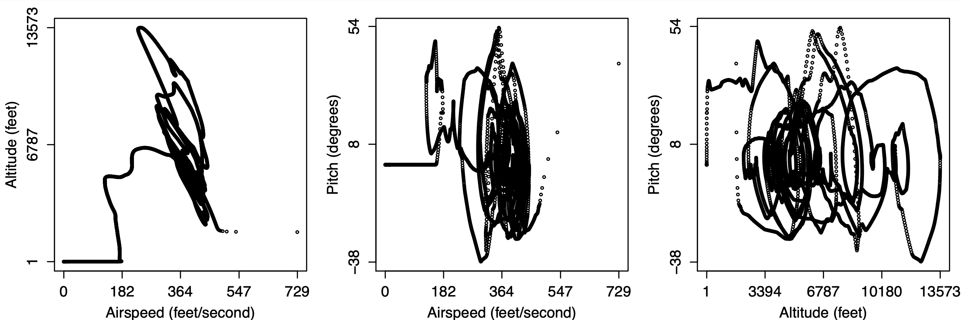
Nonlinear Data – Flight Simulator

Slide 35
Overview
Motivation
Background & related work
Identifying vehicles
Experimental data
Methodology
Results
Detecting intrusion
Experimental data
Methodology
Results
Conclusions

Slide 36
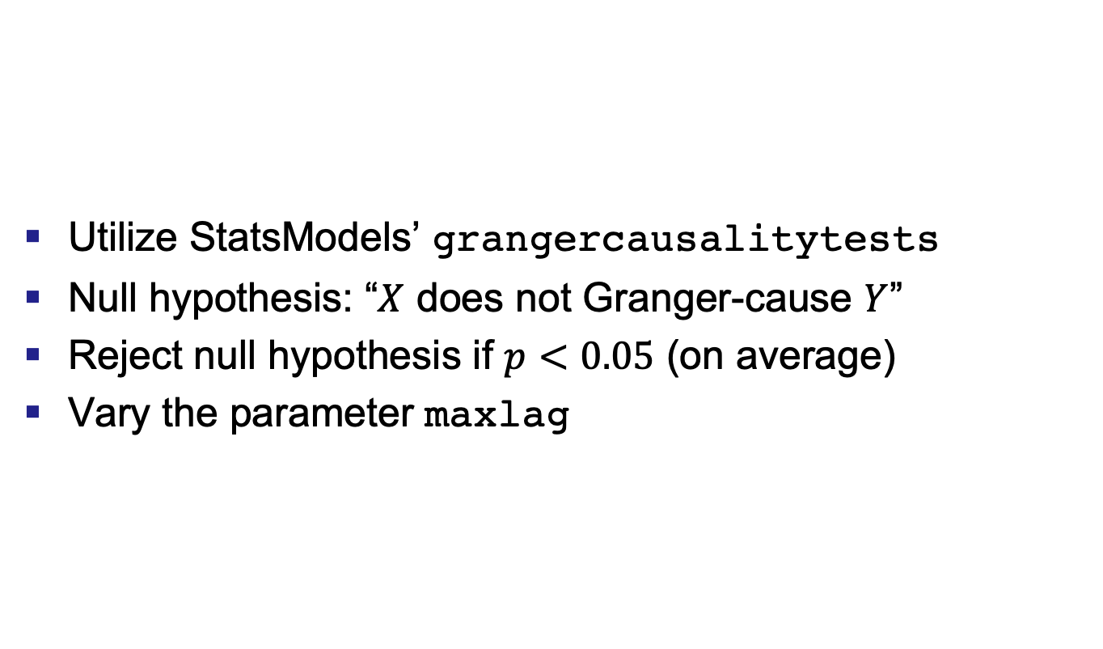
Granger Causality
Utilize StatsModels’ grangercausalitytests
Null hypothesis: “$X$ does not Granger-cause $Y$”
Reject null hypothesis if $p<0.05$ (on average)
Vary the parameter maxlag

Slide 37
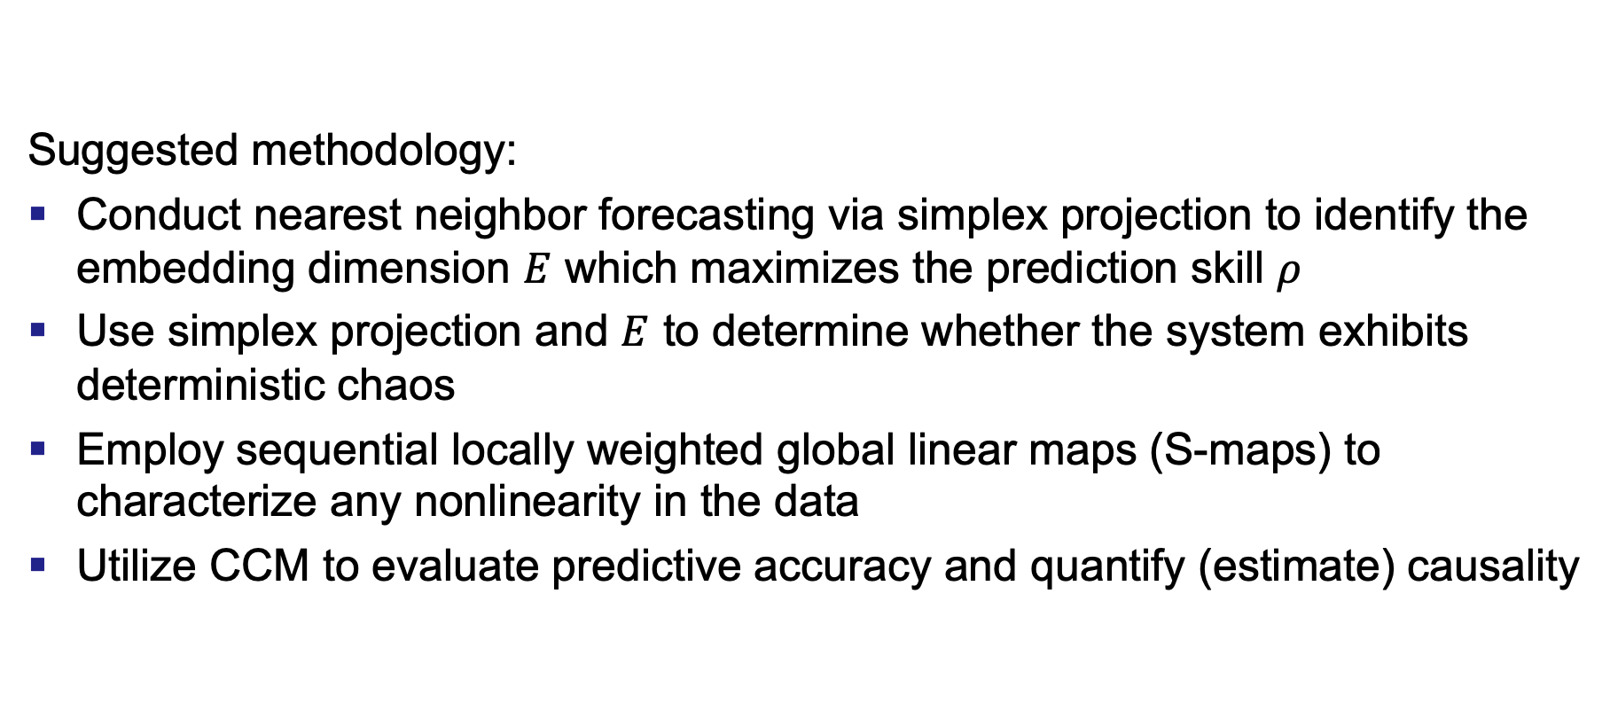
Empirical Dynamic Modeling
Suggested methodology:
Conduct nearest neighbor forecasting via simplex projection to identify the embedding dimension $E$ which maximizes the prediction skill $ρ$
Use simplex projection and $E$ to determine whether the system exhibits deterministic chaos
Employ sequential locally weighted global linear maps (S-maps) to characterize any nonlinearity in the data
Utilize CCM to evaluate predictive accuracy and quantify (estimate) causality

Slide 38
Overview
Motivation
Background & related work
Identifying vehicles
Experimental data
Methodology
Results
Detecting intrusion
Experimental data
Methodology
Results
Conclusions

Slide 39
Linear Data – Granger
Granger causality between each pair of steering system time series.

Slide 40
Linear Data – EDM
Plots illustrating the optimal embedding dimension for each steering system time series.

Slide 41
Linear Data – EDM
Plots illustrating the deterministic chaos present in each steering system time series.

Slide 42
Linear Data – EDM
Plots illustrating the nonlinearity of each steering system time series.

Slide 43
Linear Data – EDM
Plots illustrating the predictions
for each steering system time series.
Plots illustrating the prediction error
for each steering system time series.
Notes:
Be specific about “next-point predictions”

Slide 44
Linear Data – EDM
Plots illustrating the predictions
for each steering system time series.
Time Series | Naive Error | EDM Error
Steering wheel angle | 0.009424 | 0.003351
Left wheel RPM | 0.005742 | 0.003893
Right wheel RPM | 0.005742 | 0.003893
Naive and EDM root-mean-square error
for each steering system time series.

Slide 45
Linear Data – EDM
Plots illustrating the causality between each pair of steering system time series.

Slide 46
Linear Data – EDM
Plots illustrating predictive capability by analyzing the causality
between each pair of steering system time series.

Slide 47
Nonlinear Data – Granger
Granger causality between each pair of selected AVAS time series.

Slide 48
Nonlinear Data – EDM
Plots illustrating the optimal embedding dimension for each selected AVAS time series.

Slide 49
Nonlinear Data – EDM
Plots illustrating the deterministic chaos present in each selected AVAS time series.

Slide 50
Nonlinear Data – EDM
Plots illustrating the nonlinearity of each selected AVAS time series.

Slide 51
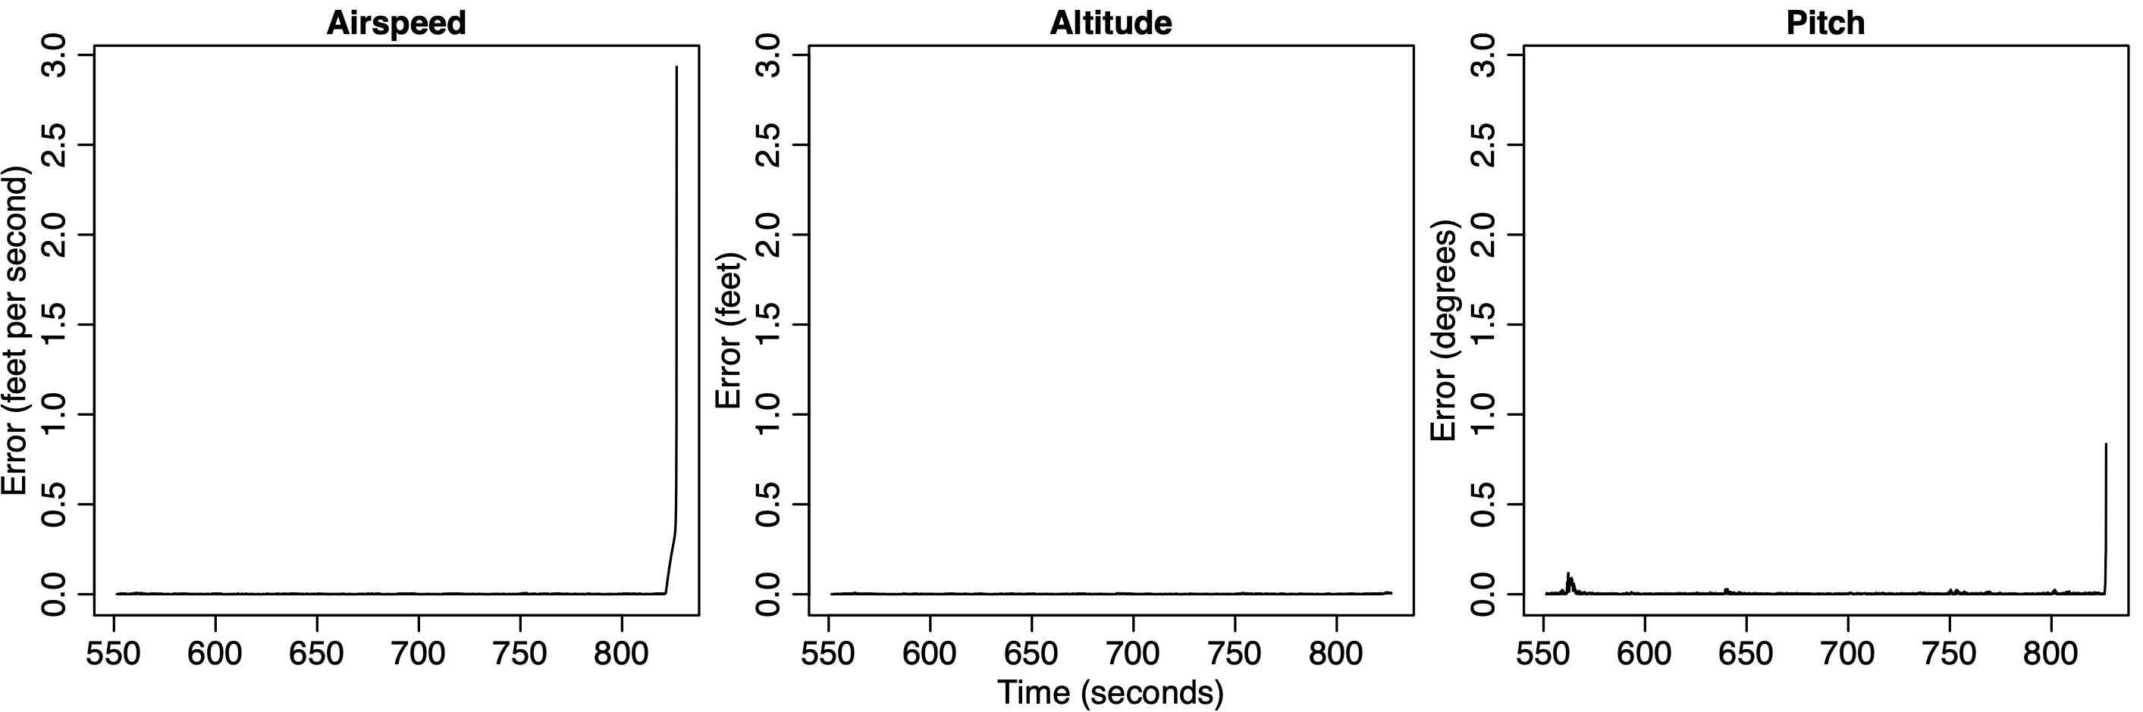
Nonlinear Data – EDM
Plots illustrating the predictions
for each selected AVAS time series.
Plots illustrating the prediction error
for each selected AVAS time series.

Slide 52
Nonlinear Data – EDM
Plots illustrating the predictions
for each selected AVAS time series.
Time Series | Naive Error | EDM Error
Airspeed | 3.907005 | 0.070161
Altitude | 18.192201 | 0.001535
Pitch | 0.013749 | 0.019748
Naive and EDM root-mean-square error
for each selected AVAS time series.

Slide 53
Nonlinear Data – EDM
Plots illustrating the causality between each pair of selected AVAS time series.

Slide 54
Nonlinear Data – EDM
Plots illustrating predictive capability by analyzing the causality
between each pair of selected AVAS time series.

Slide 55
Overview
Motivation
Background & related work
Identifying vehicles
Experimental data
Methodology
Results
Detecting intrusion
Experimental data
Methodology
Results
Conclusions

Slide 56
Conclusions
Question 1: Do CAN packets uniquely identify a vehicle?
Yes; deep learning tools can classify raw CAN data
This risks privacy and safety
Question 2: Can we develop an IDS for a CPS like the CAN?
Maybe; insight into the CPS’s behavior could enable an IDS
Granger causality does not seem to enable this insight
Linear systems are probably too simplistic for EDM
EDM may suffice for nonlinear systems
Notes:
Discuss MLPs vs. CNNs

Slide 57
Future Work
Identifying vehicles
Apply this methodology to a much larger dataset
Train a Siamese neural network to classify CAN samples
Detecting intrusion
Address the remaining steps towards an IDS
Evaluate more robust datasets/CPSs
Explore other time series analysis techniques

Slide 58
Contributions
First demonstration of the unique signature of a vehicle’s raw CAN data and a discussion of the associated risks
First in-depth presentation of advantages/disadvantages of Granger causality and EDM for linear/nonlinear data
First argument for applying EDM to IDS development
First complete library of EDM functions for use with standardized time series data
Publications
(accepted) ICCWS 2020
(pending) IFIP Critical Infrastructure Protection 2020

Slide 59
Summary
Motivation
Background & related work
Identifying vehicles
Experimental data
Methodology
Results
Detecting intrusion
Experimental data
Methodology
Results
Conclusions

Slide 60
References
ACM Transactions on Cyber-Physical Systems, “Cyber-Physical Systems (TCPS): About,” 2018. [Online]. Available: https://tcps.acm.org/about.cfm [Accessed: 2019-05-31]
BiObserver, “Visualization of Granger causality,” 2014. [Online]. Available: https: //commons.wikimedia.org/wiki/File:GrangerCausalityIllustration.svg [Accessed: 2019-09-27]
G. E. P. Box, G. M. Jenkins, and G. C. Reinsel, Time Series Analysis: Forecasting and Control. Upper Saddle River, New Jersey, USA: Prentice-Hall, Inc., 1994.
A. Burkov, The Hundred-Page Machine Learning Book. Andriy Burkov, 2019.
J. B. Cabrera, L. Lewis, X. Qin, W. Lee, and R. K. Mehra, “Proactive Intrusion Detection and Distributed Denial of Service Attacks - A Case Study in Security Management,” Journal of Network and Systems Management, vol. 10, no. 2, pp. 225–254, 2002.
J. B. Cabrera, L. Lewis, X. Qin, W. Lee, R. K. Prasanth, B. Ravichandran, and R. K. Mehra, “Proactive detection of distributed denial of service attacks using MIB traffic variables-a feasibility study,” 2001 7th IEEE/IFIP International Symposium on Integrated Network Management Proceedings: Integrated Management Strategies for the New Millennium, vol. 00, no. c, pp. 609–622, 2001.
M. Enev, A. Takakuwa, K. Koscher, and T. Kohno, “Automobile Driver Finger- printing,” in Proceedings on Privacy Enhancing Technologies, vol. 2016, no. 1, 2015, pp. 34–50.
I. Goodfellow, Y. Bengio, and A. Courville, Deep Learning. Cambridge, Massachusetts, USA: The MIT Press, 2016.
C. W. J. Granger, “Investigating Causal Relations By Econometric Models,” Econometrica, vol. 37, no. 3, pp. 424–438, 1969.
R. J. Hyndman and G. Athanasopoulos, Forecasting: Principles and Practice, 2nd ed. Melbourne, Australia: OTexts, 2018.
M. J. Kang and J. W. Kang, “Intrusion Detection System Using Deep Neural Network for In-Vehicle Network Security,” PLoS ONE, vol. 11, no. 6, pp. 1–17, 2016.
D. Kwon, H. Kim, J. Kim, S. C. Suh, I. Kim, and K. J. Kim, “A survey of deep learning-based network anomaly detection,” Cluster Computing, pp. 1–13, 2017.
J. M. Lee, Introduction to Topological Manifolds, 2nd ed. New York, New York, USA: Springer US, 2011.

Slide 61
References
M. Marchetti and D. Stabili, “Anomaly detection of CAN bus messages through analysis of ID sequences,” in 2017 IEEE Intelligent Vehicles Symposium (IV). IEEE, 2017, pp. 1577–1583.
National Instruments, “Controller Area Network (CAN) Overview,” 2019. [Online]. Available: https://www.ni.com/en-us/innovations/white-papers/06/controller-area-network--can--overview.html [Accessed: 2019-07-08]
C. Nicholson, “A Beginner’s Guide to Neural Networks and Deep Learning,” 2019. [Online]. Available: https://skymind.ai/wiki/neural-network [Accessed: 2019-09-26]
J. Perktold, S. Seabold, and J. Taylor, “StatsModels: Statistics in Python,” 2009.
X. Qin and W. Lee, “Statistical Causality Analysis of Infosec Alert Data,” in International Workshop on Recent Advances in Intrusion Detection. Springer Berlin Heidelberg, 2003, pp. 73–93.
B. Stone, S. Graham, B. Mullins, and C. Schubert Kabban, “Enabling Auditing and Intrusion Detection for Proprietary Controller Area Networks,” Dissertation, Air Force Institute of Technology, 2018.
Sugihara Lab: Quantitative Ecology and Data-Driven Theory, “Empirical Dynamic Modeling,” 2019. [Online]. Available: http://deepecoweb.ucsd.edu/ nonlinear-dynamics-research/edm/ [Accessed: 2019-05-31]
G. Sugihara, “Nonlinear forecasting for the classification of natural time series,” Philosophical Transactions of the Royal Society: Mathematical, Physical and Engineering Sciences, vol. 348, no. 1688, 1994.
G. Sugihara and R. May, “Nonlinear forecasting as a way of distinguishing chaos from measurement error in time series,” Nature, vol. 344, pp. 734–741, 1990.
G. Sugihara, R. May, H. Ye, C.-h. Hsieh, E. Deyle, M. Fogarty, and S. Munch, “Detecting Causality in Complex Ecosystems,” Science, vol. 338, no. October, pp. 496–500, 2012.
Z. Tyree, R. A. Bridges, F. L. Combs, and M. R. Moore, “Exploiting the Shape of CAN Data for In-Vehicle Intrusion Detection,” in 2018 IEEE 88th Vehicular Technology Conference (VTC-Fall), 2019, pp. 1–5.
H. Ye, A. Clarke, E. Deyle, and G. Sugihara, “rEDM: An R package for Empirical Dynamic Modeling and Convergent Cross Mapping,” pp. 1–19, 2019. [Online]. Available: https://cran.r-project.org/web/packages/rEDM/vignettes/rEDM.html [Accessed: 2019-12-12]

Slide 62
Air Force Institute of Technology
Cyber-Physical System Intrusion: A Case Study of
Automobile Identification Vulnerabilities and
Automated Approaches for Intrusion Detection
2d Lt David Crow

